Slide 1


CLINICAL DECISION SUPPORT SYSTEM
(CDSS)

Slide 2
AGENDA
Introduction
Importance of CDSS in the Healthcare Sector
Overview – Healthcare Sector in India
Need for CDSS in India
Benefits of CDSS in India
Challenges to CDSS implementation in India
Successful CDSS implementation in India
Importance of CDSS in addressing healthcare challenges in India

Slide 3

Introduction
Clinical Decision Support System is a sophisticated tool designed to assist healthcare professionals in making informed decisions by leveraging data, knowledge, and patient information.

Slide 4
Benefits of CDSS in healthcare sector
Clinical Decision Support Systems (CDSS) is a type of computerized technology that provides clinicians with information and tools to improve patient care.
CDSS uses patient data to provide evidence-based recommendations for diagnosis, treatment, and management of a patient’s condition.
In healthcare, CDSS can help healthcare professionals make informed decisions by providing them with accurate and relevant information at the point of care

Slide 5

Functions of Clinical Decision Support System
Diagnostic Support
Treatment Planning and Personalization
Treatment Planning and Personalization
Risk Stratification
Support for Education and Standardisation

Slide 6
CDSS Advantages and Disadvantages
Advantages
Disadvantages
Enhanced Decision-Making
Better Patient Outcomes
Healthcare Preventative
Efficiency and Time Savings
Drug Safety
Alert Fatigue
Integration Complexity
Problems with Data Quality and Interoperability
Cost and Resource Implications

Slide 7
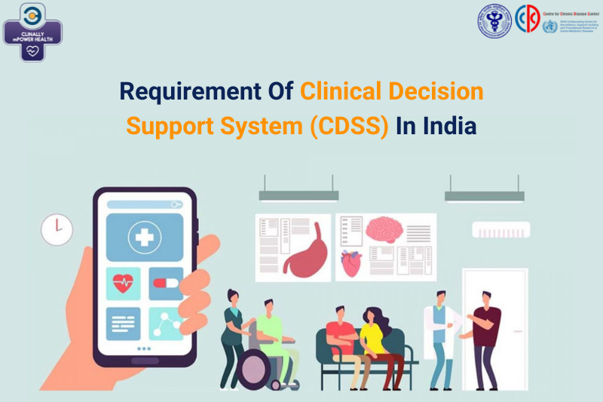
Improved patient outcomes
Enhanced accuracy and efficiency of diagnosis and treatment
Reduction in medical errors
Increased patient safety
Cost savings for patients and healthcare providers

Slide 8
Importance of CDSS in the Healthcare Sector
The healthcare sector is constantly evolving, and the use of technology has become increasingly important to improve patient outcomes
CDSS can help healthcare professionals make informed decisions by providing them with accurate and relevant information at the point of care. It can also reduce the likelihood of medical errors and improve patient safety.
CDSS can also help healthcare providers adhere to evidence-based medicine and improve clinical workflow, ultimately leading to better outcomes for patients.

Slide 9
Overview – Healthcare Sector in India
India has a diverse and complex healthcare sector, with a wide range of challenges that must be addressed to improve patient outcomes.
India faces a high burden of chronic diseases, such as diabetes and heart disease, and a shortage of healthcare professionals.
The country is also grappling with a growing burden of non-communicable diseases and the need for personalized treatment. In this context, CDSS can play a vital role in improving the quality of care and outcomes for patients.

Slide 10

Need for CDSS in India
High prevalence of chronic diseases in India
Increasing burden of non-communicable diseases
Shortage of healthcare professionals

Slide 11
Challenges to CDSS implementation in India
Lack of awareness and education
Limited access to technology and infrastructure
Data quality and interoperability
Cost
Privacy and security

Slide 12

Successful CDSS implementation in India
ClinAlly mPower Health
Apollo Hospitals
Tata Memorial Centre
Manipal Hospitals
Public Health Foundation of India

Slide 13
Importance of CDSS in addressing healthcare challenges in India
India faces significant healthcare challenges, including a high burden of communicable and non-communicable diseases, a shortage of healthcare professionals, and limited access to healthcare services in rural areas.
CDSS can help address these challenges by providing healthcare professionals with real-time recommendations, improving diagnosis and treatment, reducing medical errors, and increasing efficiency in healthcare delivery.

Slide 14

Clinical Decision Support Systems Market Report Scope
Global Clinical Decision Support Systems Market Insights Forecasts to 2030
The Clinical Decision Support Systems Market Size was valued at USD 4.55 Billion in 2021.
The Market is Growing at a CAGR of 9.1% from 2021 to 2030
The Worldwide Clinical Decision Support Systems Market is expected to reach USD 10.2 Billion by 2030
Asia Pacific is expected to grow the fastest during the forecast period

Slide 15
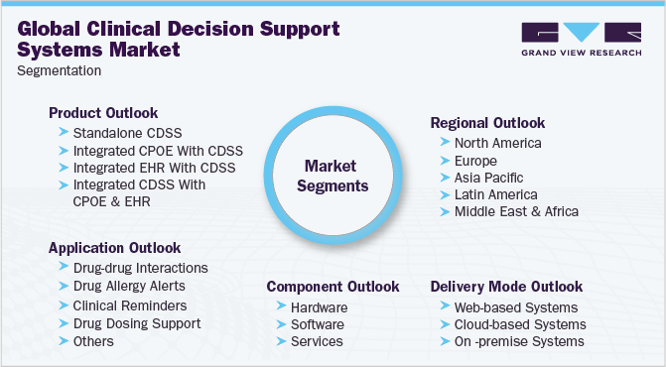

Slide 16
CONCLUSION
Healthcare professionals and policymakers in India should prioritize the implementation of CDSS in healthcare settings. This can be achieved through investing in technology infrastructure, training healthcare professionals in the use of CDSS, and creating policies that support the integration of CDSS into healthcare delivery. By doing so, India can improve healthcare outcomes, reduce costs, and increase access to healthcare services, particularly in underserved areas.

Slide 17


